Slide 1
Frequency Distribution & Histogram

Slide 2
Following data represents the plant height (cm) of a sample of 30 plants.
87 91 89 88 89 91 87 92 90 98 95 97 96 100 101 96 98 99 98 100 102 99 101 105 103 107 105 106 107 112
Classes | Frequency (f) | c.f. | r.f. | % freq
86–90 | 6 | 6 | 0.200 | 20.0
91–95 | 4 | 10 | 0.133 | 13.3
96–100 | 10 | 20 | 0.333 | 33.3
101–105 | 6 | 26 | 0.200 | 20.0
106–110 | 3 | 29 | 0.100 | 10.0
111–115 | 1 | 30 | 0.033 | 3.3
Total | 30 |  | 1.000 | 100.0
Frequency distribution &
Histogram

Slide 3
Frequency Distribution
Tabular arrangement of data in which various items are arranged into classes or groups and the number of items falling in each class is stated.
The number of observations falling in a particular class is referred to as class frequency "f".
Data presented in the form of a frequency distribution is also called grouped data.

Slide 4
Some definitions
Class Limits
The class limits are defined as the number or the values of the variables which are used to separate two classes. Sometimes classes are taken as 20--25, 25--30 etc In such a case, these class limits means " 20 but less than 25", "25 but less than 30" etc
Class marks or midpoints
The class mark or the midpoint is that value which divides a class into two equal parts. It is obtained by dividing the sum of lower and upper class limits or class boundaries of a class by 2.
Class interval
The difference between either two successive lower class limits or two successive upper class limits OR
The difference between two successive midpoints.
denoted by "h".

Slide 5
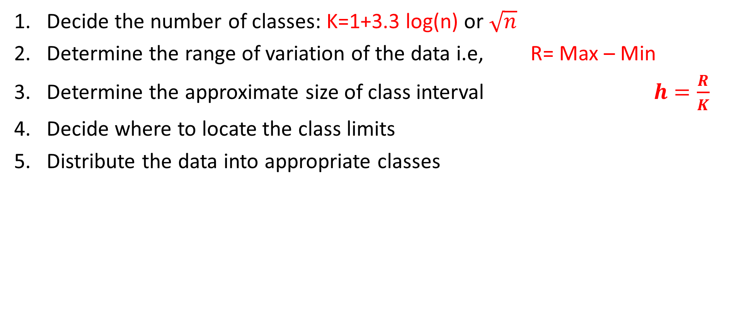
Construction of a frequency distribution
Decide the number of classes: K=1+3.3 log(n) or $\sqrt{n}$
Determine the range of variation of the data i.e, R= Max – Min
Determine the approximate size of class interval $h=\frac{R}{K}$
Decide where to locate the class limits
Distribute the data into appropriate classes

Slide 6
Example
The following data represents the height of 30 wheat plants taken from the experimental area. Construct a frequency distribution and appropriate graphs to explain the distribution of data:
87 91 89 88 89 91 87 92 90 98 95 97 96 100 101 96 98 99 98 100 102 99 101 105 103 107 105 106 107 112

Slide 7
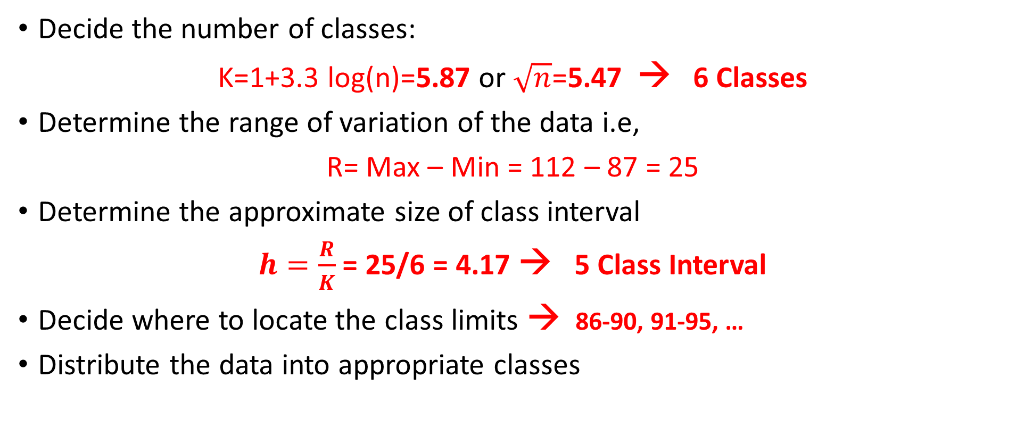
Construction of a frequency distribution
Decide the number of classes:
K=1+3.3 log(n)=5.87 or $\sqrt{n}$=5.47 → 6 Classes
Determine the range of variation of the data i.e,
R= Max – Min = 112 – 87 = 25
Determine the approximate size of class interval
$h=\frac{R}{K}$ = 25/6 = 4.17 → 5 Class Interval
Decide where to locate the class limits → 86-90, 91-95, …
Distribute the data into appropriate classes

Slide 8
Frequency Distribution
Classes
86–90
91–95
96–100
101–105
106–110
111–115
Total
Class Boundaries
85.5–90.5
90.5–95.5
95.5–100.5
100.5–105.5
105.5–110.5
110.5–115.5
Tally
Freq (f)
6
4
10
6
3
1
30
c.f.
6
10
20
26
29
30
r.f.
0.200
0.133
0.333
0.200
0.100
0.033
1.000
% freq
20.0
13.3
33.3
20.0
10.0
3.3
100.0
Cumulative % freq
20.00
33.3
66.6
86.6
96.6
100.0

Slide 9
Class Boundaries
Class Boundaries
Subtract any Upper Class Limit from its Subsequent Lower Class limit and divide the difference with 2, you will get the Continuity correction factor
Subtract this factor from all Lower Class Limits and add it to all Upper Class limits.
For example, 91-90 = ½ =0.05 or 96-95 = ½ =0.05

Slide 10
Histogram

Slide 11
Frequency Polygon
Frequency polygons are a graphical device for understanding the shapes of distributions. They serve the same purpose as histograms, but are especially helpful for comparing sets of data.
Mid Points vs Frequency

Slide 12
Cumulative Frequency Polygon / Ogive
A cumulative frequency polygon is a plot of the cumulative frequency against the upper class boundary with the points joined by a line segment.
Upper Class Boundaries vs Cumulative Frequency

Slide 13
Stem & Leaf Display
A relatively small data set can be represented by stem and leaf display.
In addition to information on the number of observations falling in the various classes, it displays details of what those observations actually are.
Each number in the data set is divided into two parts, a Stem and a Leaf. A stem is the leading digit(s) of each number and is used in sorting, while a leaf is the rest of the number or the trailing digit(s) and shown in display.

Slide 14
Example
Represent the following data by Stem and Leaf display by
(i) taking 10 unit as the width of the class
(ii) taking 5 unit as the width of the class
32 45 38 41 49 36 52 56 51 62 63 59 68
Steam 3* 3. 4* 4. 5* 5. 6* 6. | Leaf 2 8 6 1 5 9 2 1 6 9 2 3 8 | *indicate 0—4 .indicate 5—9 * and . are called placeholder
Steam 3 4 5 6 | Leaf 2 8 6 5 1 9 2 6 1 9 2 3 8

Slide 15
Example
Use the data below to make a stem-and-leaf plot by taking 10 as a unit.
Stem
7
8
9
10
11
12
13
Leaf
0 5 8 9
4 5 5 8
0 2 2 3 7 9
0 4 7 8
0 4 5 6 6
1 3 6 9
1 1 2
85 | 115 | 126 | 92 | 104
85 | 116 | 100 | 121 | 123
79 | 90 | 110 | 129 | 108
107 | 78 | 131 | 114 | 92
131 | 88 | 97 | 99 | 116
93 | 84 | 75 | 70 | 132
7 0 5 8 9
These values are 70, 75, 78 and 79

